Slide 1
Chapter 14 – Association Rules and Collaborative Filtering
Data Mining for Business Analytics in R
Shmueli, Bruce, Yahav, Patel & Lichtendahl

Slide 2
What are Association Rules?
Study of “what goes with what”
“Customers who bought X also bought Y”
What symptoms go with what diagnosis
Transaction-based or event-based
Also called “market basket analysis” and “affinity analysis”
Originated with study of customer transactions databases to determine associations among items purchased

Slide 3
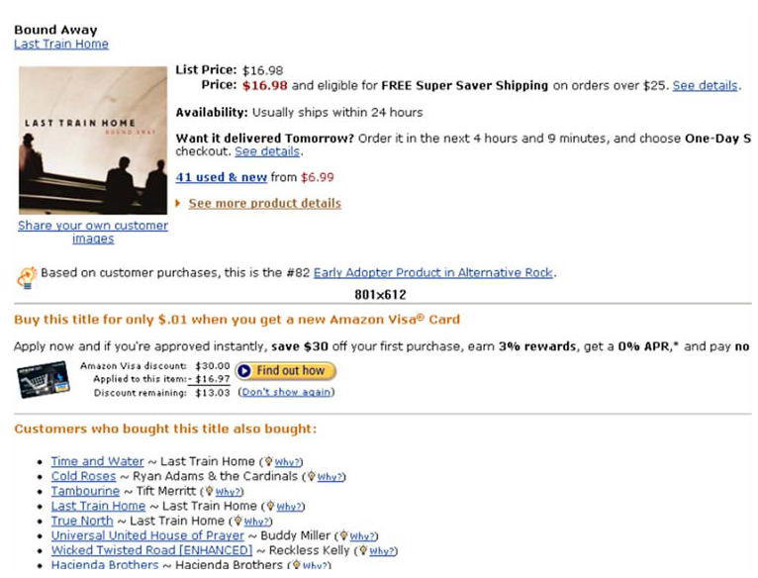
Used in many recommender systems

Slide 4
Generating Rules

Slide 5
Terms
“IF” part = antecedent
“THEN” part = consequent
“Item set” = the items (e.g., products) comprising the antecedent or consequent
Antecedent and consequent are disjoint (i.e., have no items in common)

Slide 6
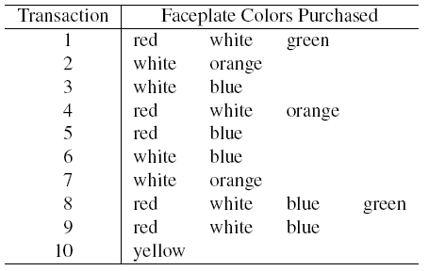

Tiny Example: Phone Faceplates

Slide 7
Many Rules are Possible
For example: Transaction 1 supports several rules, such as
“If red, then white” (“If a red faceplate is purchased, then so is a white one”)
“If white, then red”
“If red and white, then green”
+ several more

Slide 8
Frequent Item Sets
Ideally, we want to create all possible combinations of items
Problem: computation time grows exponentially as # items increases
Solution: consider only “frequent item sets”
Criterion for frequent: support

Slide 9
Support
Support for an itemset = # (or percent) of transactions that include an itemset
Example: support for the item set {red, white} is 4 out of 10 transactions, or 40%
Support for a rule = # (or percent) of transactions that include both the antecedent and the consequent

Slide 10
Apriori Algorithm

Slide 11
Generating Frequent Item Sets
For k products…
User sets a minimum support criterion
Next, generate list of one-item sets that meet the support criterion
Use the list of one-item sets to generate list of two-item sets that meet the support criterion
Use list of two-item sets to generate list of three-item sets
Continue up through k-item sets

Slide 12
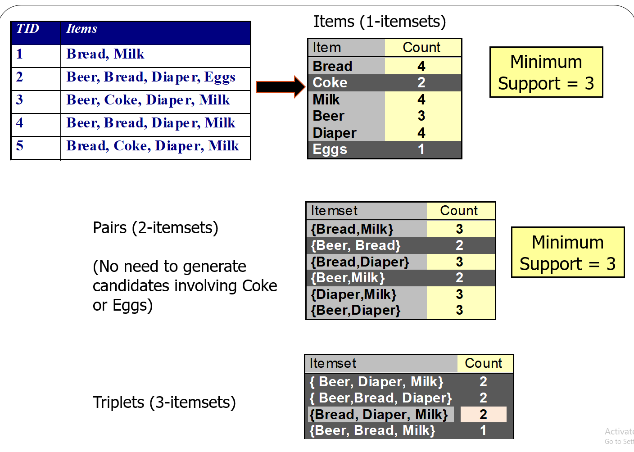

Slide 13
Measures of Performance
Confidence: the % of antecedent transactions that also have the consequent item set
Lift = confidence/(benchmark confidence)
Benchmark confidence = transactions with consequent as % of all transactions
Lift >1 suggests that the presence of the antecedent increases the chances that the consequent will occur in a given transaction
Lift < 1 indicates that purchasing the antecedent reduces the chances of purchasing the consequent in the same transaction.
Lift =1, indicates that purchasing the antecedent makes no difference on the chances of purchasing the consequent

Slide 14
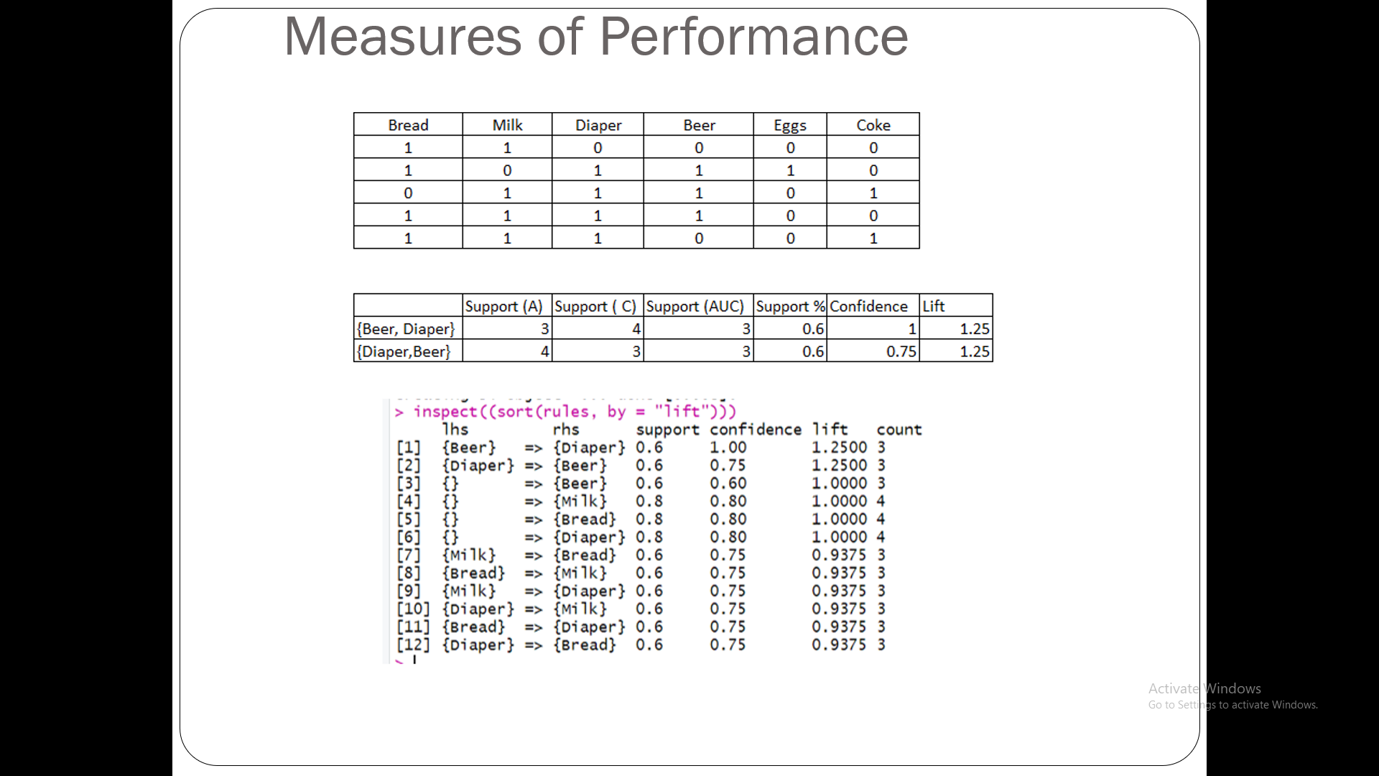

Slide 15
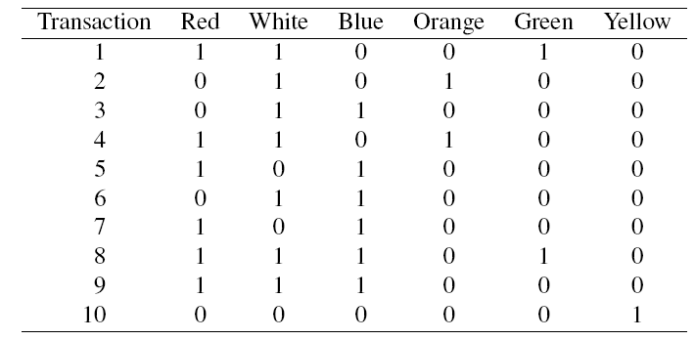
Alternate Data Format: Binary Matrix

Slide 16
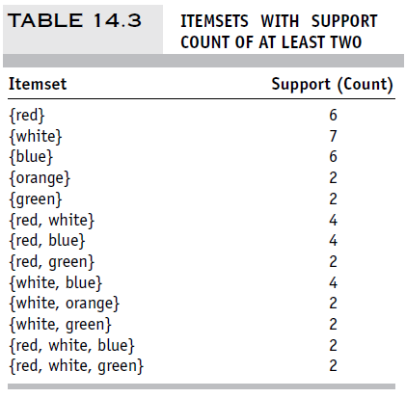
Support for Various Itemsets

Slide 17
Process of Rule Selection
Generate all rules that meet specified support & confidence
Find frequent item sets (those with sufficient support – see above)
From these item sets, generate rules with sufficient confidence

Slide 18
Example: Rules from {red, white, green}
{red, white} > {green} with confidence = 2/4 = 50%
[(support {red, white, green})/(support {red, white})]
{red, green} > {white} with confidence = 2/2 = 100%
[(support {red, white, green})/(support {red, green})]
Plus 4 more with confidence of 100%, 33%, 29% & 100%
If confidence criterion is 70%, report only rules 2, 3 and 6

Slide 19
Generating Rules in R
fp.df <- read.csv(“Faceplate.csv”)
# remove first column and convert to matrix
fp.mat <- as.matrix(fp.df[, -1])
# convert the binary incidence matrix into a transactions database
fp.trans <- as(fp.mat, "transactions")
inspect(fp.trans)
## get rules
# when running apriori(), include minimum support & confidence, & target as arguments.
rules <- apriori(fp.trans, parameter = list(supp = 0.2, conf = 0.5, target = "rules"))
output (sorted by lift)
P(green) if you use the rule
How much better your chances of getting a green are if you use the rule than if you select randomly
lhs rhs support confidence lift
15 {Red,White} => {Green} 0.2 0.5 2.500000
5 {Green} => {Red} 0.2 1.0 1.666667
14 {White,Green} => {Red} 0.2 1.0 1.666667
4 {Orange} => {White} 0.2 1.0 1.428571
6 {Green} => {White} 0.2 1.0 1.428571
13 {Red,Green} => {White} 0.2 1.0 1.428571

Slide 20
Interpretation
Lift ratio shows how effective the rule is in finding consequents (useful if finding particular consequents is important)
Confidence shows the rate at which consequents will be found (useful in learning costs of promotion)
Support measures overall impact

Slide 21
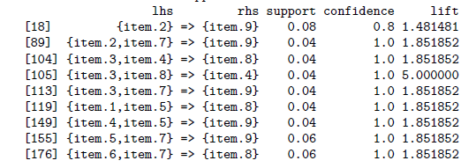
Caution: The Role of Chance
Random data can generate apparently interesting association rules. The more rules you produce, the greater this danger.
Rules based on large numbers of records are less subject to this danger.
Rules from some randomly-generated transactions:
Even chance data can produce high lift

Slide 22
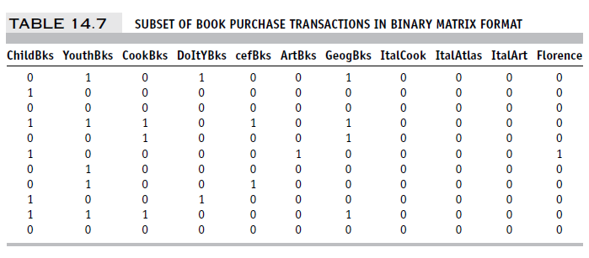
Example: Charles Book Club
Row 1, e.g., is a transaction in which books were bought in the following categories: Youth, Do it Yourself, Geography

Slide 23
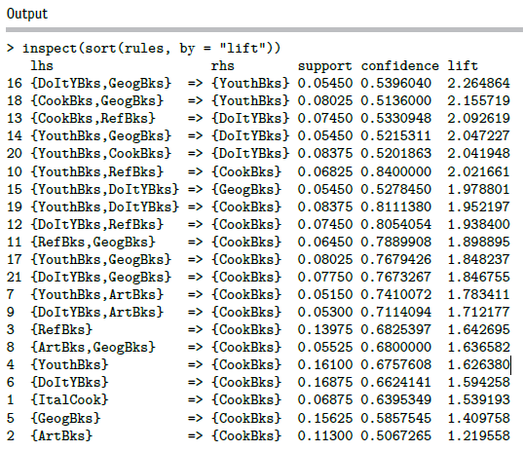
Rules Produced by apriori
Cautions:
Duplication (same trio of books)
No useful info!
rules <- apriori(books.trans,
parameter = list(supp= 200/4000, conf = 0.5, target = "rules"))

